Slide 1
Iterative Combinatorial Auctions:
Theory and Practice
By David C.Parkes and Lyle H.Ungar
Represented by Igal Kaplan

Slide 2
Introduction
In this paper we introduce iBundle – an iterative combinatorial auction that allows agents to bid for bundles of items while the auctioneer increases prices and maintains a provisional allocation.
Bundles are important in many real-world problems. For example : consider a manufacturer that needs either components A and B, or just component C.

Slide 3
Introduction (continue)
Although combinatorial auctions can be approximated by multiple auctions on single items, this often results in inefficient outcomes.
iBundle is the first iterative combinatorial auction that is optimal for a reasonable agent bidding strategy, in this case myopic utility-maximizing agents that place best-response bids to prices.
In this paper we prove the optimality of iBundle with a novel connection to primal-dual optimization theory (Papadimitriou & Steiglitz 1982) .

Slide 4
Advantages and Disadvantages
iBundle has many computational advantages over the only other known optimal combinatorial auction, the Generalized Vickrey Auction (GVA).
In iBundle as in an iterative auction, agents can incrementally compute values for different bundles of items as prices change, and make new bids in response to bids from other agents.
In comparison, the GVA is a sealed-bid auction, in which agents first submit bids simultaneously, and then the auctioneer determines an allocation and payments, the agent’s optimal strategy is to bid for, and compute the value of, all bundles for which it has positive value.

Slide 5

Advantages and Disadvantages (continue)
This is often impossible, since for |G| items there are bundles to value, each of which may require solving a difficult optimization problem.
However, combinatorial auctions introduce new computational complexities in mechanism execution. In particular, the auctioneer’s winner-determination (WD) problem, the problem of choosing bids to maximize revenue, is NP – hard by reduction from the maximal weighted clique problem.
In iBundle the auctioneer must solve a sequence of WD problems (one in each round) to maintain a provisional allocation as agents bid.

Slide 6
Advantages and Disadvantages (continue)
In comparison, in GVA the auctioneer must solve one WD problem for each agent in the final allocation.
But! Each WD problem in iBundle is smaller than in the GVA, because agents bid for less bundles.
In addition, the auctioneer can increase the minimal bid increment and reduce the number of rounds to termination, reducing computation for some loss in economic efficiency.
Further speed-ups are achieved through caching of solutions from previous rounds in the auction, and introducing approximate WD algorithms.

Slide 7
Advantages and Disadvantages (continue)
We note that the GVA has stronger truth-revelation properties than iBundle. Truthful bidding is optimal in the GVA whatever the bids of other agents.
In comparison, rational agents with look ahead could manipulate the outcome of iBundle to their advantage, and lead to the sub optimal allocations.
However, there is some evidence that myopic biding may be a reasonable assumption in practice, perhaps because of the computational complexity of strategic behavior.

Slide 8
The Ascending-Price Bundle Auction
iBundle is an ascending-price auction that allows agents to bid on arbitrary combinations of items during the auction. The auctioneer increases prices on bundles as bids are received and maintains a set of winning bids that maximize revenue.
Let G denote the set of items to be auctioned, I denote the set of agents, and S (sub set of G) denote a bundle of items. The auction proceeds in rounds, indexed t => 1.
Bids. Agents can place exclusive-or bids for bundles (XOR). Those bids provide completely expressibility, but are not necessarily computationally efficient for all problems.

Slide 9
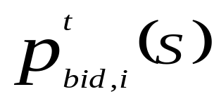

Definitions - Bids (continue)
Agent i associates a bid price with a bid for bundle S in round t, non-negative by definition. The price must either be within of, or greater than, the ask price announced by the auctioneer (see below). Parameter > 0 defines the minimal bid increment, the minimal price increase in the auction.
Agents must repeat bids for bundles in the current allocation, but can bid at the same price if the ask price has increased since the previous round.
An agent can also bid below the ask price for any bundle in any round – but then it cannot bid a higher price for that bundle in the future. This allows an agent to bid for a bundle priced slightly above its value.

Slide 10
Definitions – continue
Winner-determination: The auctioneer solves a winner-determination problem in each round, computing an allocation of bundles to agents that maximizes revenue. The auctioneer must respect agent’s XOR bid constrains, and can’t allocate any item to more than one agent. The provisional allocation becomes the final one when the auction terminates.
Approximate Winner-determination: The auctioneer can also use an approximate algorithm for WD, and still maintain the same incentives for myopic agents to follow the same bidding strategy. To achieve this an algorithm must have the bid monotonicity property.

Slide 11
Definitions – continue
Definition 1: Bid monotonicity. An algorithm for WD satisfies bid monotonicity if whenever an agent i is allocated a bundle with bids Bi, it is also allocated a bundle with bids Bi U B that include a bid for an additional bundle B.
It is straightforward to prove that optimal WD algorithms are bid-monotonic.

Slide 12
Definitions – continue
Prices: The price-update rule generalizes the rule in the English auction, which is an ascending-price auction for a single item. In the English auction the price is increased whenever two or more agents bid for the item at the current price.
In iBundle the price on a bundle is increased when one or more agents that do not receive a bundle in the current allocation bid at (or above) the current ask price for a bundle. The price is increased to the minimal bid increment above the greatest failed bid price. The initial ask prices are zero.

Slide 13
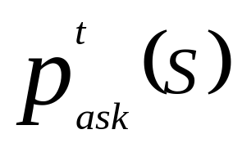
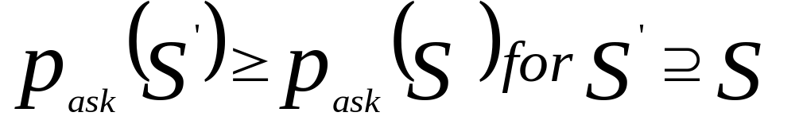
Definitions – continue
The auctioneer announced a new ask price in round t, for all bundles S that increase in price -
Other bundles are implicitly priced at least as high as the greatest price for any bundle they contain, i.e.
These ask prices are anonymous, the same for all agents.

Slide 14
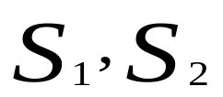
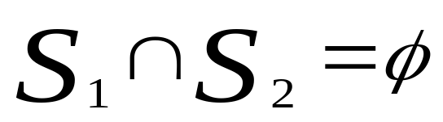
Definitions – continue
Price discrimination: In some problems the auctioneer introduces price discrimination based on agent’s bids, with different ask prices to different agents, when this is necessary to achieve an optimal allocation. A simple rule dynamically introduces price discrimination on an agent-by-agent basis, when an agent submits bids that are not safe :
Definition 2: Safe bids. An agent’s bids are safe if the agent is allocated a bundle in the current allocation, or it doesn’t bid at or above the ask price for any pair of compatible bundles
such that

Slide 15
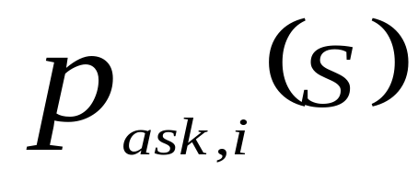
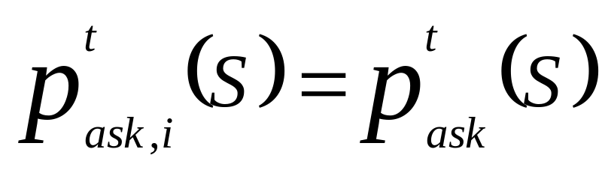
Definitions – continue
Suppose agent i bids unsuccessfully for compatible bundles S1 and S2 in round t . It is still possible that bids for bundles S1 and S2 from two different agents can be successful at the prices. Remember that the XOR bid constraint prevents the auctioneer accepting both bids from agent i.
When an agent’s bid are not safe the agent receives individual ask price in the future rounds.
Individual prices are initialized to the current general prices.

Slide 16
Definitions – continue
And increases to the minimal increment above the agent’s bids in future rounds that the agent receives no bundle in the provisional allocation.
Termination: The auction terminates when :
[T1] all agents submit the same bids in two consecutive rounds
[T2] all agents that bid receive a bundle

Slide 17
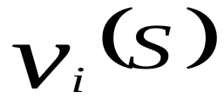
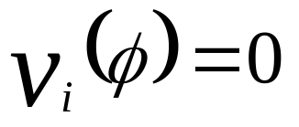
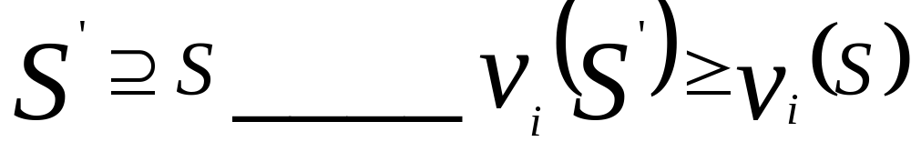
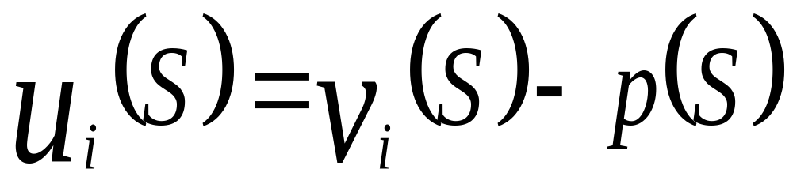
A Myopic Best-Response Bidding Strategy
The agents are myopic in the sense that they only consider the current round of the auction.
Let denote agent i’s value for bundle S, and assume and free disposal of items, so that for all
Consider a risk-neutral agent with a quasi-linear utility fun.
for bundle S

Slide 18
Best response – continue
Further, assume that agents are indifferent to within a utility of plus minus the minimal bid increment, this is reasonable as the minimal bid increment goes to zero.
The myopic best response strategy is to submit XOR bid for all bundles S that maximizes utility at the current prices.
This maximizes the probability of a successful bid for bid-monotonic WD algorithms.

Slide 19

Theoretical Results
Theorem 1. iBundle terminates with an allocation that is within 3min{|G|,|I|} of the optimal solution, for myopic best-response agent bidding strategies.
The auction is optimal as the bid increment approaches zero because the error-term goes to zero.
However, iBundle requires price discrimination, and this can be hard to enforce.
For example, the auctioneer must prevent agents entering the auction under multiple pseudonyms, and also prevent the transfer of items in an after-market.

Slide 20

Theoretical Results - continue
In a simpler variation, iBundle(2), the auctioneer never price discriminates between agents. From Theorem 1, this variation is optimal at least when bids are safe (this condition is sufficient but not necessary):
Theorem 2. iBundle(2) terminates with an allocation that is within 3min{|G|,|I|} of the optimal solution when bids are safe, for myopic best-response agent bidding strategies.
As an example, bids are safe if each agent bids for a set of conflicting bundles in every round of the auction. iBundle(2) also probably solves the following problems without price discrimination:

Slide 21
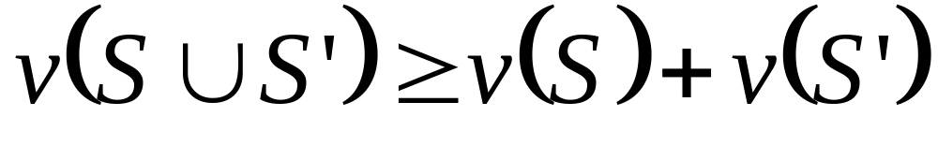
Theoretical Results - continue
(1) Every agent demands different bundles.
(2) Agents have additive or superadditive values, i.e.
for non conflicting bundles S and S’
(3) The bundles that receive bids throughout the auction are from a single partition of items, e.g. all bids are for pairs of matching shoes, or single items.

Slide 22
Theoretical Results - continue
In experimental tests iBundle(2) performs well in many hard problems, achieving an average of 99% allocative efficiency (computed as a ratio of the total value of the allocation across all agents to the value of the optimal allocation) compared to 82% from non-combinatorial auctions in the same problems.
We found that price discrimination only had a noticeable effect on allocative efficiency with very small bid increments, and after many rounds of bidding.

Slide 23
Proof of Optimality
The proof of iBundle optimality is inspired by a proof due to Bertsekas (1990) for a simpler iterative auction, and makes an interesting connection with primal-dual theory of linear programming.
A problem is first formulated both as a primal and a dual linear program. A primal-dual algorithm searches for feasible primal and dual solutions that satisfy complementary slackness (CS) conditions, instead of searching for an optimal primal (or dual) solution directly.

Slide 24
Proof of Optimality - continue
CS expresses logical relationships between the values of primal and dual solutions that are necessary and sufficient for optimality:
Complementary-Slackness Theorem. Feasible primal and dual solutions are optimal if and only if they satisfy complementary slackness conditions.

Slide 25
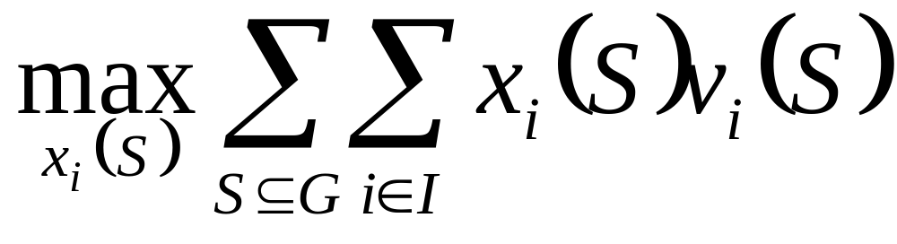
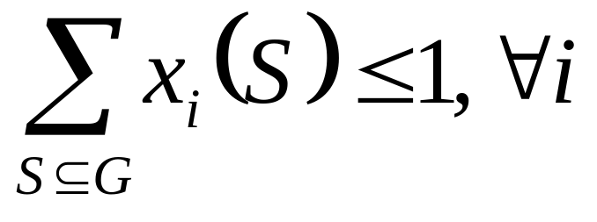
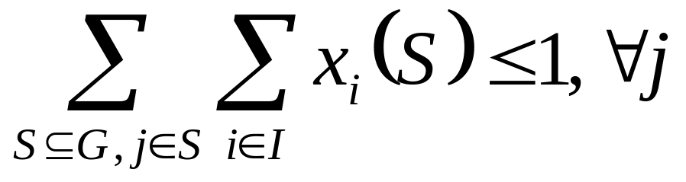
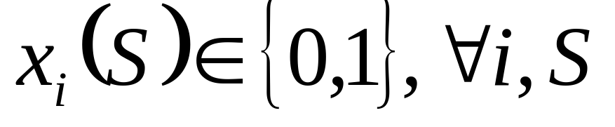
Proof of iBundle(2)
integer program:
s.t. (IP-1)
(IP-2)

Slide 26
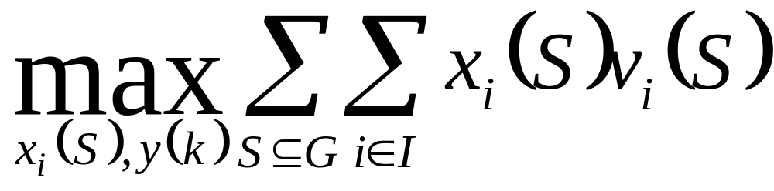

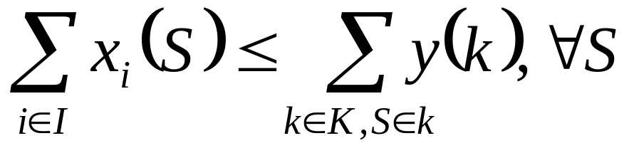
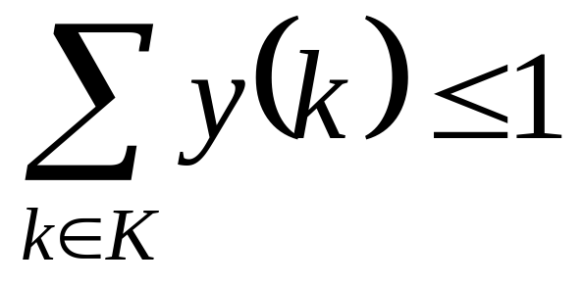
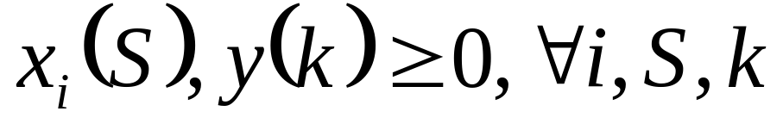
Proof of iBundle(2) – continue
primal linear program
s.t. (LP-1)
(LP-2)
(LP-3)

Slide 27
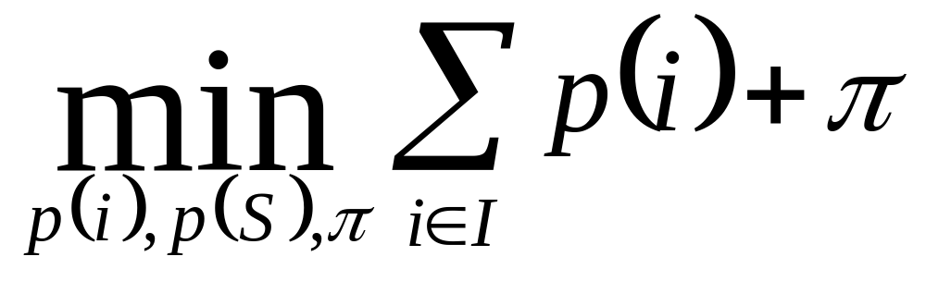
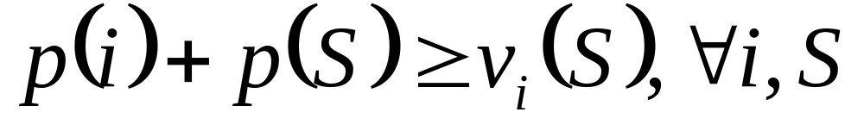
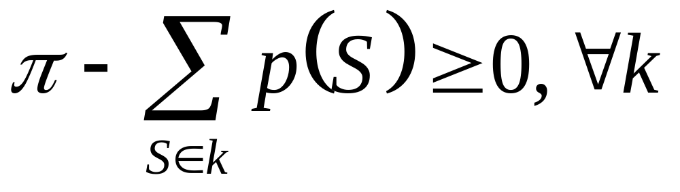
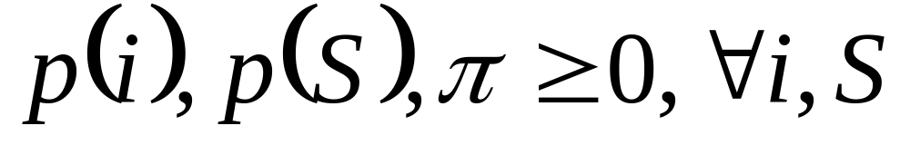
Proof of iBundle(2) – continue
dual linear program
s.t. (DLP-1)
(DLP-2)

Slide 28
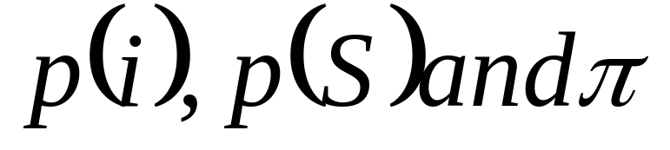
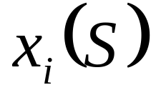
Proof of iBundle(2) – continue
In dual problem variables
Correspond to constrains (LP-1), (LP-2) and (LP-3) respectively, and dual constrains (DLP-1) and (DLP-2) correspond to primal variables and y(k).
When the primal solution is integral the dual problem computes competitive equilibrium bundle prices that minimize the sum of agent utility and auctioneer revenue.
We prove that iBundle(2) implements a primal-dual algorithm for LP and DLP, and computes integral solution for LP, when agents follow myopic best-response bidding strategies and bids are safe.

Slide 29
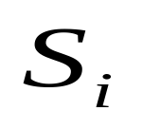
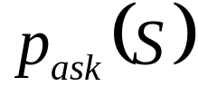
Proof of iBundle(2) – continue
First, we show that the allocation and prices in each round of the auction correspond to feasible primal and dual solutions. Then we show that the primal and dual solutions satisfy CS when the auction terminates.
Let denote the provisional allocation to agent i, and denote the ask price for bundle S.

Slide 30
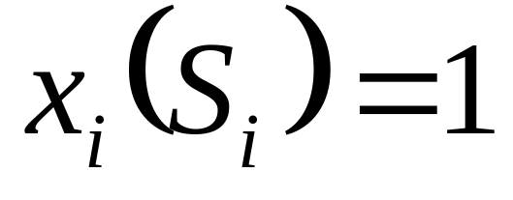
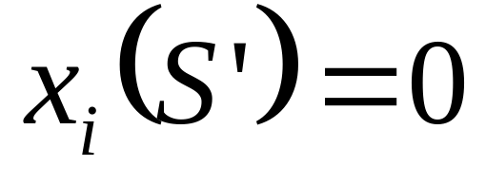
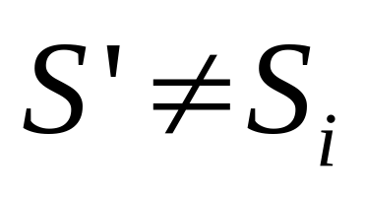
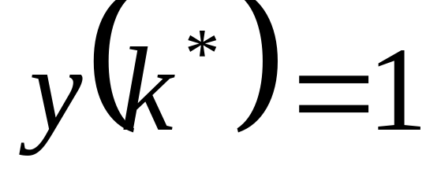
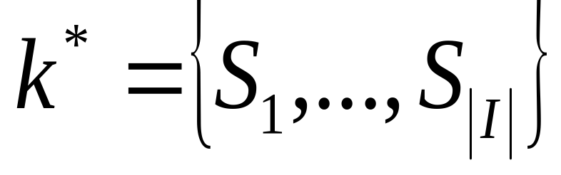
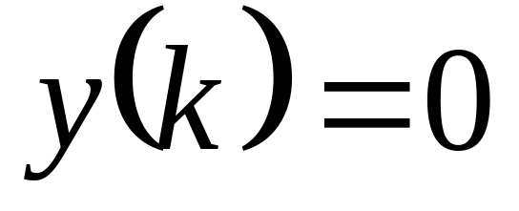
Proof of iBundle(2) – continue
Feasible primal.
and
for all
partition
for
and otherwise

Slide 31
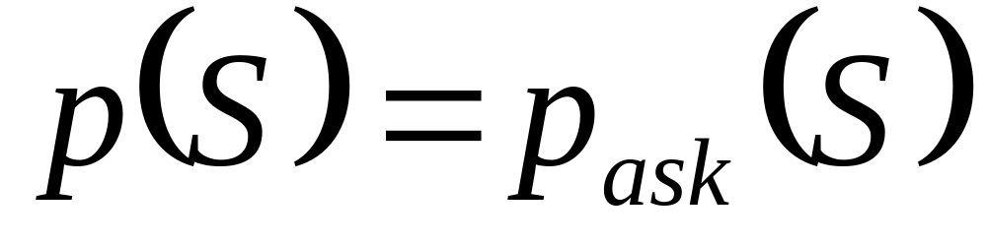
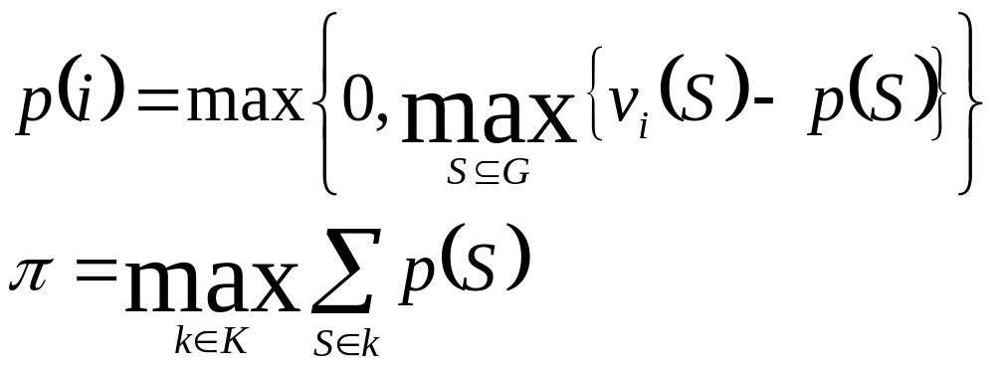
Proof of iBundle(2) – continue
Feasible dual.
Constrains (DLP-1) and (DLP-2) are satisfied with assignments:
(1)
(2)

Slide 32
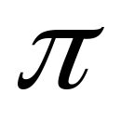
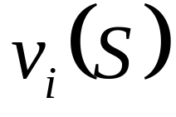
Proof of iBundle(2) – continue
The value p(i) can be interpreted as agent i’s maximum utility at the prices, and can be interpreted as the maximum revenue that the auctioneer can achieve at the prices.
The auctioneer doesn’t explicitly compute the value of p(i), rather we prove that the allocation and prices in the auction satisfy CS with these assignments when the auction terminates, based on the bids placed by agents.
This is just as well, because the values remain private information to agents during the auction.

Slide 33
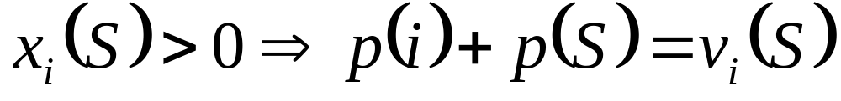
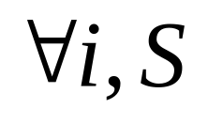
Proof of iBundle(2) – continue
Complementary-slackness conditions. The first primal CS condition, (CS-1) is:
Given (1) it states that all agents must only receive bundles that maximize utility at the current prices . (CS-1) is maintained throughout the auction because bundles are only allocated according to bids from agents, and agents place best-response bids. Formally, for any bundle S bid by agent i:

Slide 34
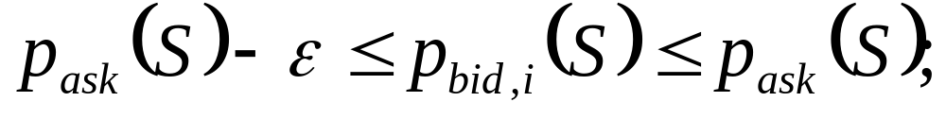
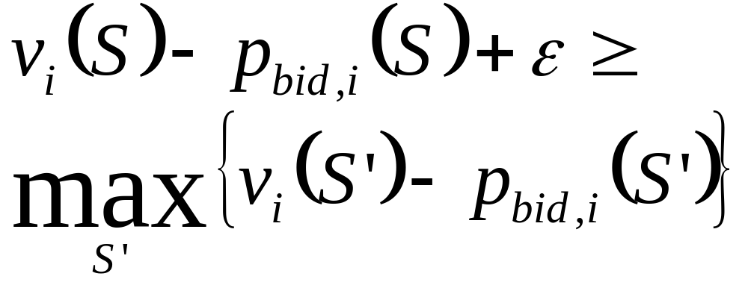
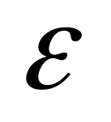
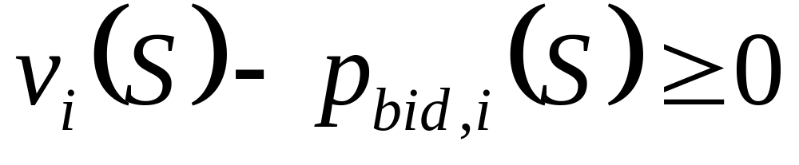
Complementary-slackness conditions.
(i)
(ii)
because agents bid for bundles that maximize utility within
(iii)

Slide 35

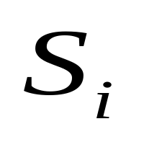
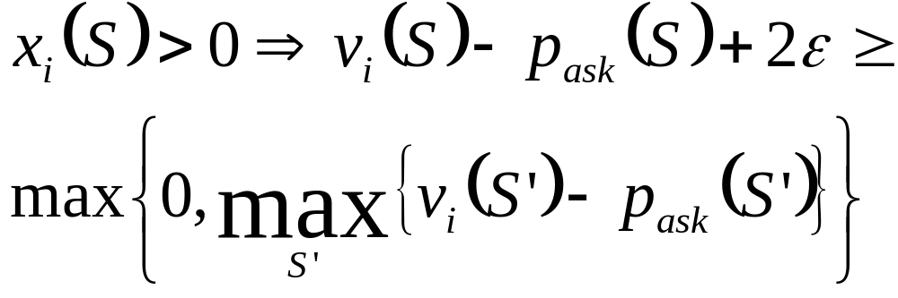
Complementary-slackness conditions.
because agents only bid for bundles with positive utility.
Since
implies agent i bid for bundle
,we have:

Slide 36
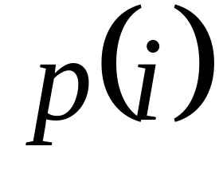
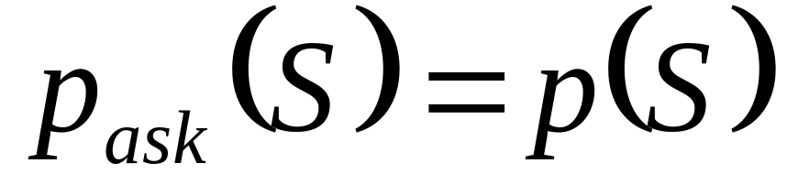
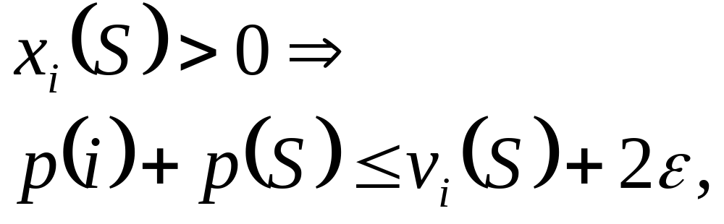

Complementary-slackness conditions.
Substituting for and
,we prove e-CS-1

Slide 37
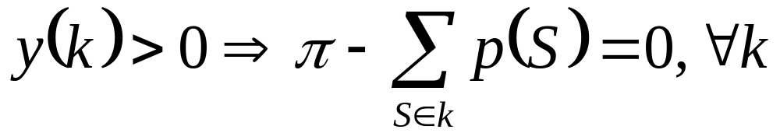
Complementary-slackness conditions.
The second primal CS condition, (CS-2), is:
Given (2) it states that the allocation must maximize the auctioneer’s revenue at prices p(S), over all possible allocations.

Slide 38




Complementary-slackness conditions.
(i) Agent i with one of the highest losing bid for bundle S in round t will continue to bid for bundle S in round t+1. Let
denote agent i’s utility for bundle S in round t. Then
because the ask price for S increased by
Also,
for all bundles S’ the agent didn’t bid in round t.

Slide 39


Complementary-slackness conditions.
Hence, with
because the price of S’ can only increase in round t+1, we have
and a bid for S’ can never exclude a bid for S from agent i’s best response bids in round t+1.
A similar argument can be made for utility of bundles that the agent did bid in round t.

Slide 40



Complementary-slackness conditions.
(ii) No single agent causes the price to increase to its current level on a pair of compatible bundles. This follows because price updates are due to safe bids from agents.
Therefore, for partition k* such that y(k*)=1,
,because
, and

Slide 41


Complementary-slackness conditions.
Because of (i) and (ii), i.e. the constraints to allocate to agents’ bids are not binding.
Finally, with (2) we have
because
and an allocation can include no more bundles than there are agents or items. We prove e-CS-2:

Slide 42


Complementary-slackness conditions.
The first dual condition , (CS-3) is:
Given (1) it states that every agent with positive utility for some bundle at the current prices must receive a bundle in the allocation. (CS-3) is only satisfied during the auction for agents that receives bundles in the provisional allocation, but we prove (CS-3) for all agents when iBundle(2) terminates.

Slide 43

Complementary-slackness conditions.
In termination case [T2] every agent that bids receives a bundle, so we immediately have (CS-3) with myopic best-response agents.
In case [T1] some agents may bid and receive no bundles.
However, these agents must bid at below the ask price and have values just below ask prices, otherwise prices would increase and their bids would change.

Slide 44



Complementary-slackness conditions.
Finally, the last pair of dual CS conditions, (CS-4) and (CS-5):
The assignment y(k*)=1 for the partition
trivially satisfies the RHS of both conditions.

Slide 45
Proof of iBundle(2) - Termination
By contradiction, assume the auction never terminates. Informally, [T1] implies that agents must submit different bids in successive rounds, but with myopic best-response bidding this implies that prices must increase, and agents must eventually bid above their values for bundles. We prove a contradiction with myopic best-response bidding strategies.

Slide 46


Putting it all together.
Summing e-CS-1 over all agents in the final allocation, and with p(i)=0 for agents not in the allocation by (CS-3) ,
because an allocation can include no more bundles than there are items or agents.
Introducing e-CS-2, because y(k*)=1 for the bundle-set that corresponds to the final allocation Si, then

Slide 47





Putting it all together - continue
Finally, adding these two equations, we have
The LHS is the value of the final dual solution,
and the first-term on the RHS is the value of the final primal
solution, . We know , where is
the value of the optimal primal solution by the weak duality
property of linear programs.

Slide 48


Putting it all together - continue
Thus, because
it follows that
Finally, because the primal solution is integral (by construction during iBundle), it is a feasible and optimal solution to the combinatorial resource allocation problem [IP].
In addition, it follows immediately that iBundle(2) terminates in competitive equilibrium when agents are myopically rational and place safe bids.

Slide 49
Proof of iBundle
A simple transformation of agents’ bids allows iBundle to be implemented within iBundle(2) and ensures that agents’ bids remain safe throughout the auction.
Whenever bids from agent i are not safe in iBundle(2) we can simulate the price-update rule in iBundle by introducing a new dummy item that is specific to that agent, call it Xi.
This item is concatenated by the auctioneer to all bids from agent i in this round and all future rounds.
It has the following effects:

Slide 50
Proof of iBundle – continue
1. The outcome of winner-determination, or the allocative efficiency of the auction, is unchanged because no other agent bids for item Xi.
2. Agent i’s bids are always safe because every bid includes item Xi, and no pair of bids is compatible.
3. The price increases due to bids from agent i are isolated to that agent in all future rounds because all price increases are for bundles that include item Xi.
The optimality of iBundle follows immediately from the optimality of iBundle(2).

